Slide 1
THE 12 MINOR PROPHETS: Jonah
Forgiveness Given To God’s Enemies

Slide 2
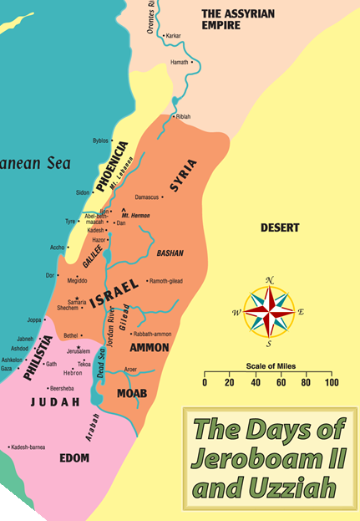
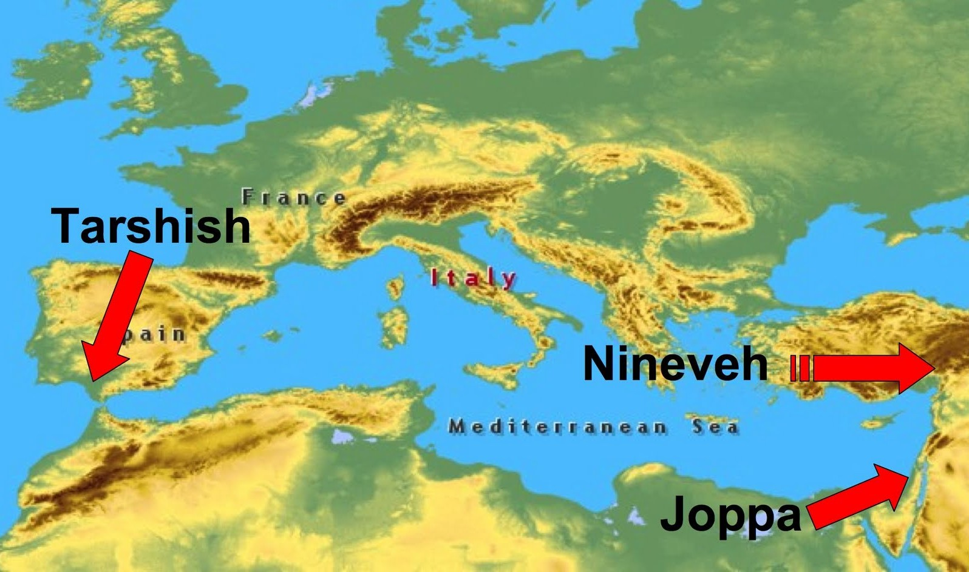
Last Week: You can run but you can’t hide!

Slide 3
Matthew 16:4
4 An evil and adulterous generation wants a sign; and so a sign will not be given to it, except the sign of Jonah.” And He left them and went away.

Slide 4
Listen for this:
DOES REPENTENCE REQUIRE ASKING TO BE FORGIVEN?

Slide 5
THAT’S GREEK TO ME…UNLESS IT’S HEBREW!
OLD TESTAMENT:
NACHAM – TO LAMENT, TO GRIEVE (DIFFERENT COURSE OF ACTION; think turn from)
SHUB – RADICAL CHANGE OF MIND TOWARD SIN; AGREEMENT WITH GOD (CONSCIOUS MORAL SEPARATION FROM SIN AND AGREEMENT TO FORSAKE IT; think agree and turn to God)
NEW TESTAMENT:
METAMELOMAI – TO HAVE CARE, CONCERN, REGRET (SIMILAR TO REMORSE)
METANOEO – TO HAVE ANOTHER MIND, A RADICAL CHANGE TURNING FROM IDOLS OF SIN AND SELF TO GOD

Slide 6
THE NATURE OF REPENTANCE
IT’S ALL ABOUT THE HEART
A HEART THAT HAS EYES AND FEET

Slide 7
EXAMPLES OF A HEART WITH FEET AND EYES
Prodigal Son (Luke 15:21), David (Psalm 51:4) and Saul (Acts 9: 4-6)

Slide 8
Jonah 2
Listen for this

Slide 9
JONAH 2
1 Then Jonah prayed to the Lord his God from the stomach of the fish,
2 and he said, “I called out of my distress to the Lord, And He answered me. I called for help from the depth of Sheol; You heard my voice.

Slide 10
THERE IS A REVERSE TO GOD HEARING Isaiah 1:15-17
15 When you spread out your hands in prayer, I hide my eyes from you; even when you offer many prayers, I am not listening. Your hands are full of blood!

Slide 11
THERE IS A REVERSE TO GOD HEARING Isaiah 1:15-17
16 Wash and make yourselves clean. Take your evil deeds out of my sight; stop doing wrong. 17 Learn to do right; seek justice. Defend the oppressed. Take up the cause of the fatherless; plead the case of the widow.

Slide 12
ALWAYS A GOOD FINISH FOR GOD’S PEOPLE Isaiah 65:24-25
24 It will also come to pass that before they call, I will answer; while they are still speaking, I will listen.
25 The wolf and the lamb will graze together, and the lion will eat straw like the ox; and dust will be the serpent’s food. They will do no evil or harm on all My holy mountain,” says the Lord.

Slide 13
Knowing Gods Word In The Dark Places
- In my distress I called upon the LORD, and cried out to my God; He heard my voice from His temple (Psalm 18:6)
- Deep calls unto deep at the noise of Your waterfalls; all Your waves and billows have gone over me (Psalm 42:7)
- For I said in my haste, "I am cut off from before Your eyes"; nevertheless You heard the voice of my supplications when I cried out to You (Psalm 31:22)

Slide 14
JONAH 2
3 For You threw me into the deep, Into the heart of the seas, And the current flowed around me. All Your breakers and waves passed over me.
4 So I said, ‘I have been cast out of Your sight. Nevertheless I will look again toward Your holy temple.’

Slide 15
JONAH 2
5 Water encompassed me to the point of death. The deep flowed around me, Seaweed was wrapped around my head.
6 I descended to the base of the mountains. The earth with its bars was around me forever, But You have brought up my life from the pit, LORD my God.

Slide 16
JONAH 2
7 While I was fainting away, I remembered the LORD, And my prayer came to You, Into Your holy temple.
8 Those who are followers of worthless idols Abandon their faithfulness,

Slide 17
JONAH 2
9 But I will sacrifice to You With a voice of thanksgiving. That which I have vowed I will pay. Salvation is from the LORD.”
10 Then the LORD commanded the fish, and it vomited Jonah up onto the dry land.

Slide 18
Next week: Delivering the Message
God forgives His enemies

